Slide 1

The Crossroads of Geography and Networks
Michael T. Goodrich
Dept. of Computer Science
w/ David Eppstein, Kevin Wortman,
Darren Strash, and Lowell Trott

Slide 2
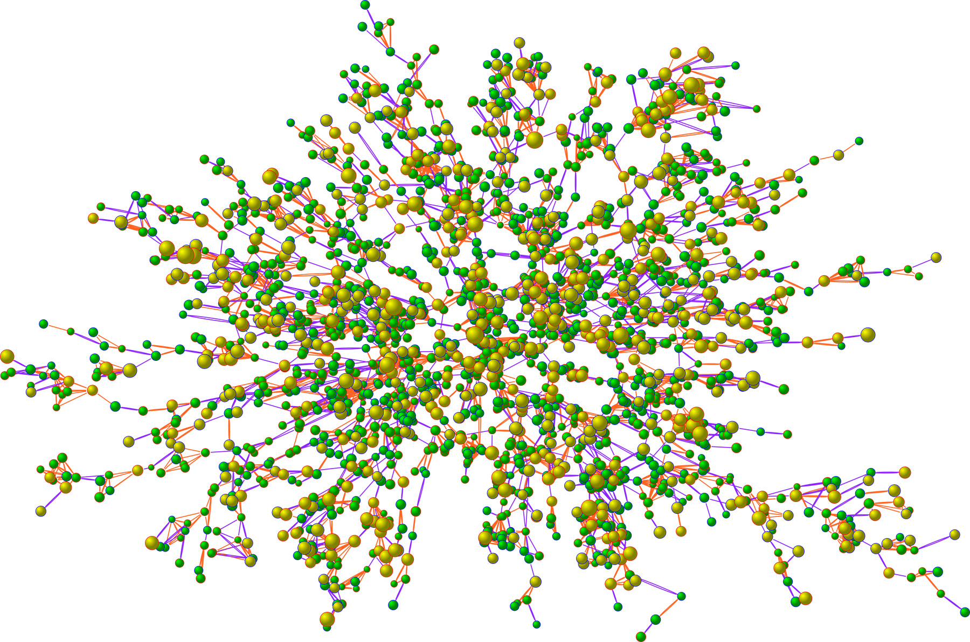
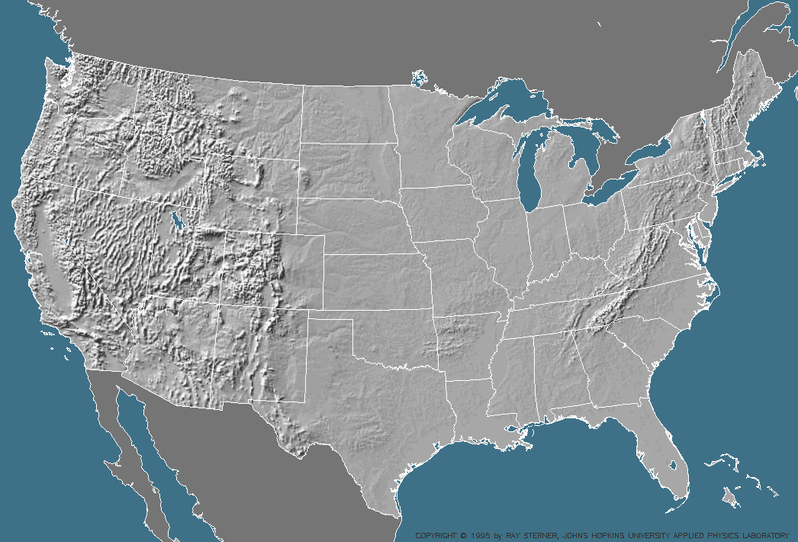
General Theme
Blend network and geographic information
+

Slide 3

Topics of Study
Road Networks as social networks
Network Voronoi diagrams
Greedy routing
Network visualization
Metric embeddings

Slide 4
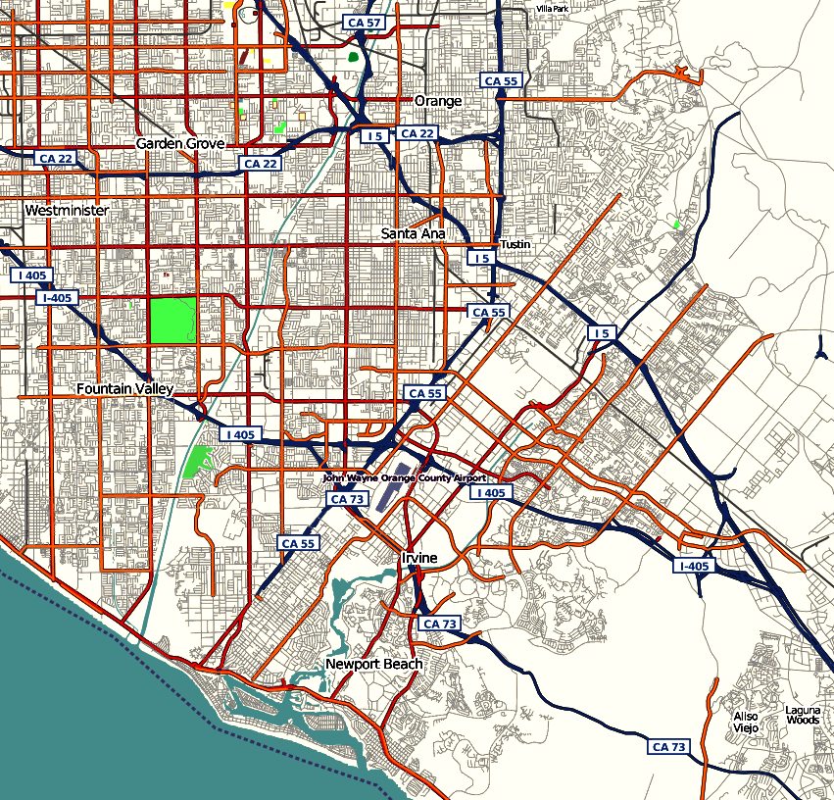
1. Road Networks as Social Networks
Study road networks as first-class network objects
Image from http://www.openstreetmap.org/index.html under CC Attribution 2.0 License

Slide 5
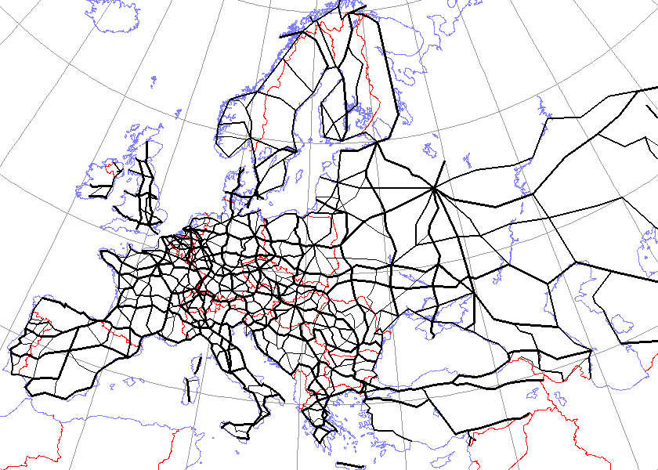
Approach: C-T-G for Algorithms
Discover inherent combinatoric, topological and geometric properties of road networks that can improve algorithms that operate on such networks.
Use an algorithmic worldview to provide new computational insights, models, and metaphors
Image by Argus fin from http://commons.wikimedia.org/wiki/Image:International_E_Road_Network.png, and is in the public domain

Slide 6
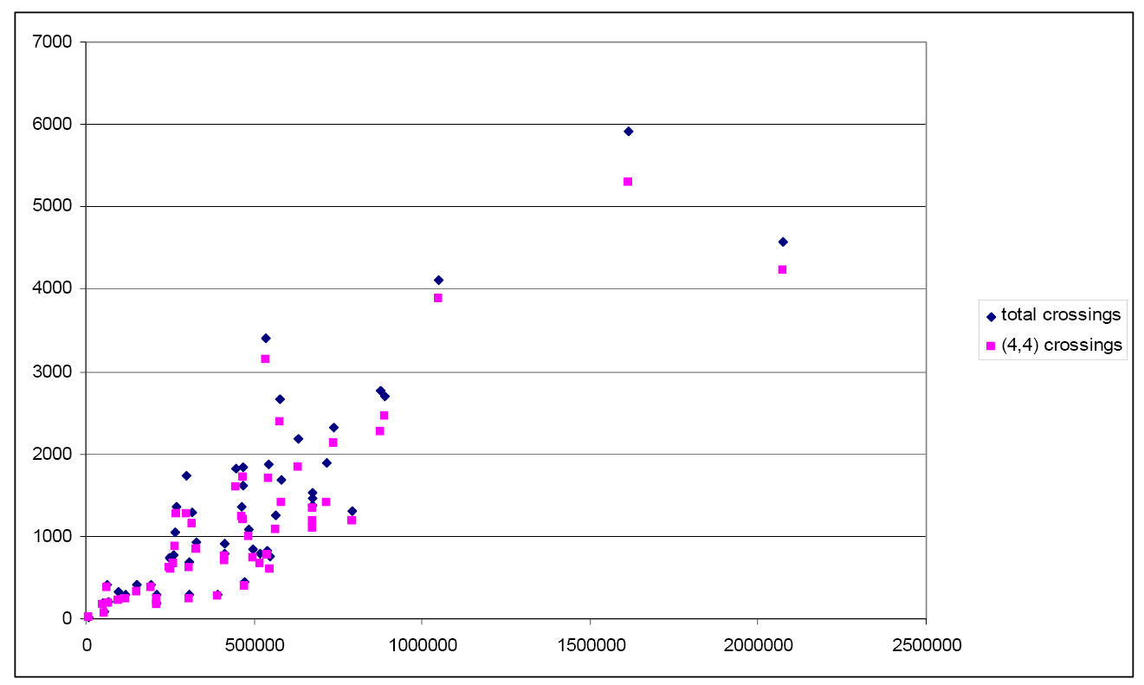
The World is Not Flat (or Spherical)
Road networks are highly non-planar. [Eppstein, Goodrich 09]
In particular, a road network with n vertices typically has a number of edge crossing proportional to
Data is from the U.S. TIGER/Line road network database, as provided by the Ninth DIMACS Implementation Challenge

Slide 7
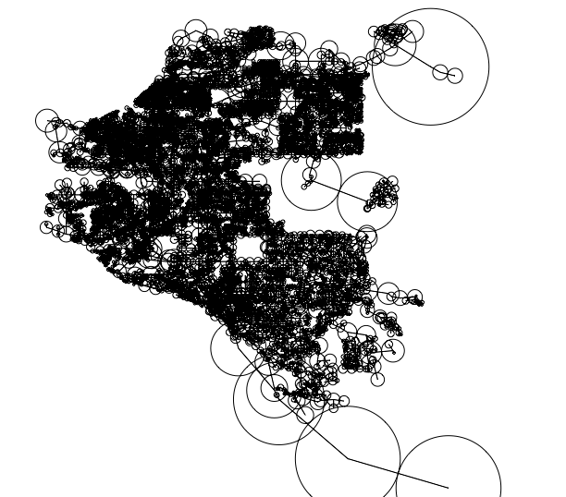
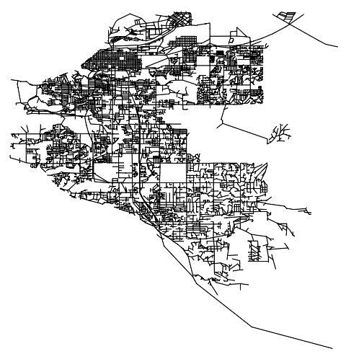
The Natural Disk Neighborhood System for Road Networks
For each vertex v, define a disk with radius equal to half the length of the longest road adjacent to v.
The road network is guaranteed to be a subgraph of this Natural Disk Neighborhood System.
Data is from the U.S. TIGER/Line road network database, as provided by the Ninth DIMACS Implementation Challenge

Slide 8
Problem: Find the crossings
Use the fact that there is a sublinear number of crossings to find all the crossings in linear time.
Data is from the U.S. TIGER/Line road network database, as provided by the Ninth DIMACS Implementation Challenge

Slide 9
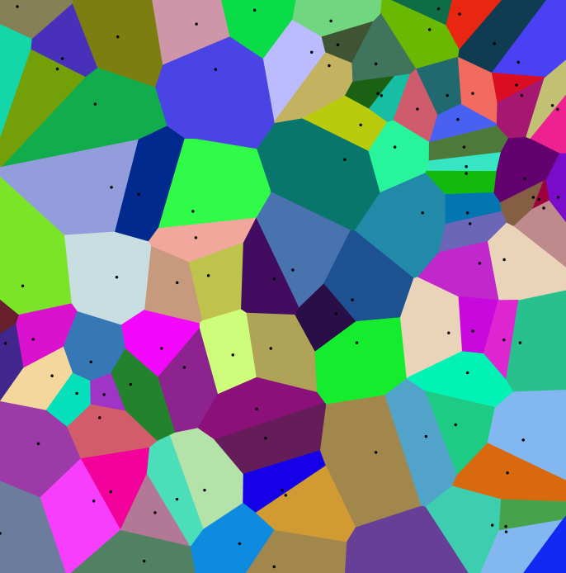
2. Network Voronoi Diagrams
A Voronoi diagram in a graph starts with a set S of k sites and determines for each other vertex v its nearest neighbor in S. E.g., the sites in S could be fire stations or hospitals.
Image by Mysid from http://commons.wikimedia.org/wiki/Image:Coloured_Voronoi_2D.svg, under GFDL 1.2

Slide 10
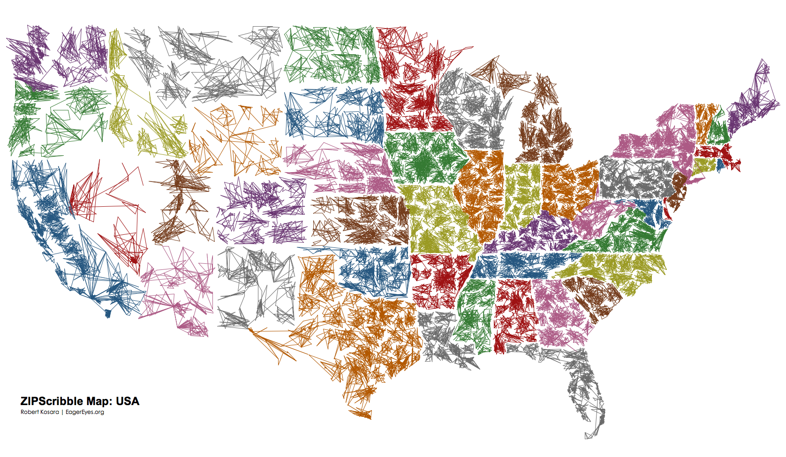
Approach: Study Network Proximity
ZCTA Adjacency Project: Determine the actual proximity of zip code regions in the U.S.
image source: http://eagereyes.org/Applications/ZIPScribbleMap.html

Slide 11
3. Greedy Routing
Network nodes have real or virtual coordinates in a metric space and route by the greedy rule:
  If vertex v receives a message with destination w, forward this message to a neighbor of v that is closer than v to w.

Slide 12
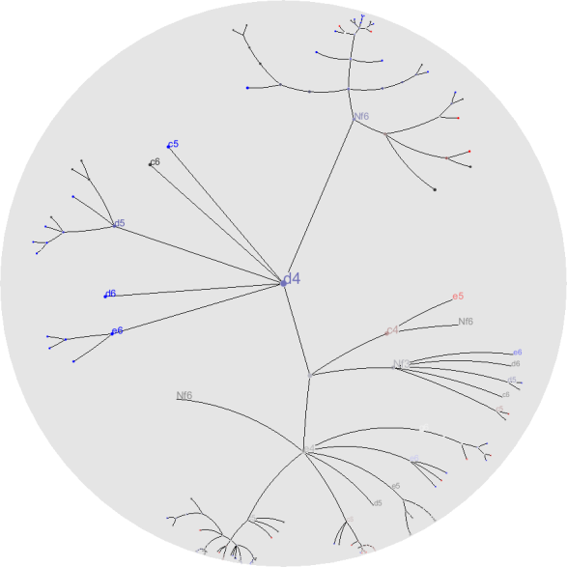


Approach: Hyperbolic Greedy Routing
Find a spanning tree, T, for the graph G
Decompose T into disjoint paths, organized in hierarchical log-depth tree
Embed T into a contrived metric space – the Dyadic Tree Metric Space (so that paths in T are greedy)
Embed the Dyadic Tree Metric Space into the hyperbolic plane, H, so that greedy paths remain greedy
T
Dyadic tree
H
Third image is from http://en.wikipedia.org/wiki/HyperbolicTree, and is in the public domain

Slide 13
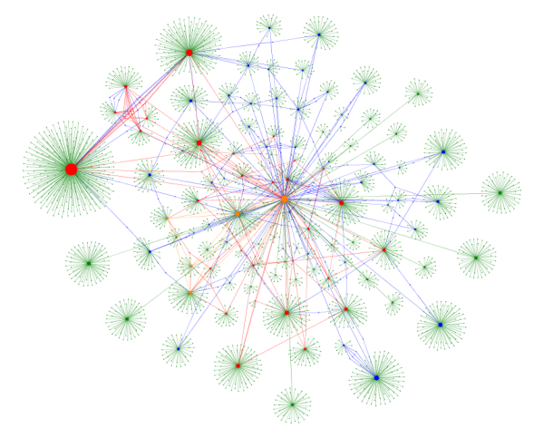
4. Network Visualization
Geometric ways of visualizing network data.

Slide 14
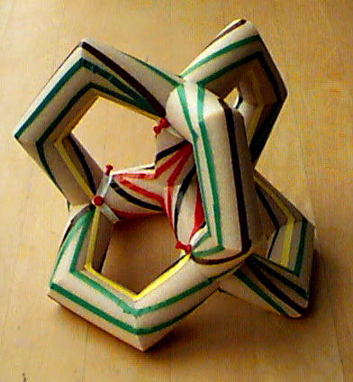
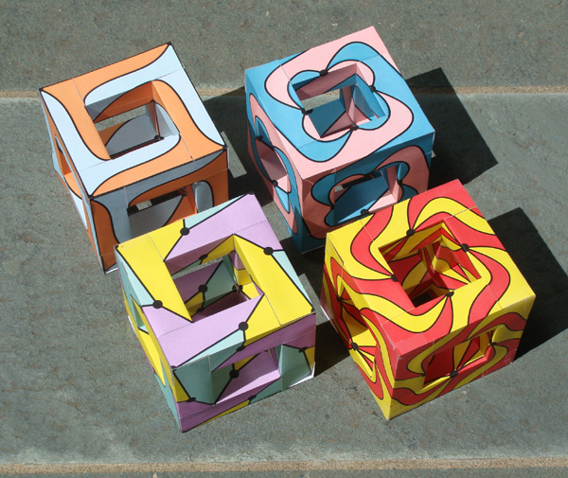
Approach: Graphs on Surfaces
This project is focused on algorithms for graphs in geometric spaces, directed at
  Methods for producing geometric configurations from networks
  Higher-genus embeddings

Slide 15
5. Metric Embeddings
Study distance metrics in networks
  Simplifications
  Embeddings

Slide 16
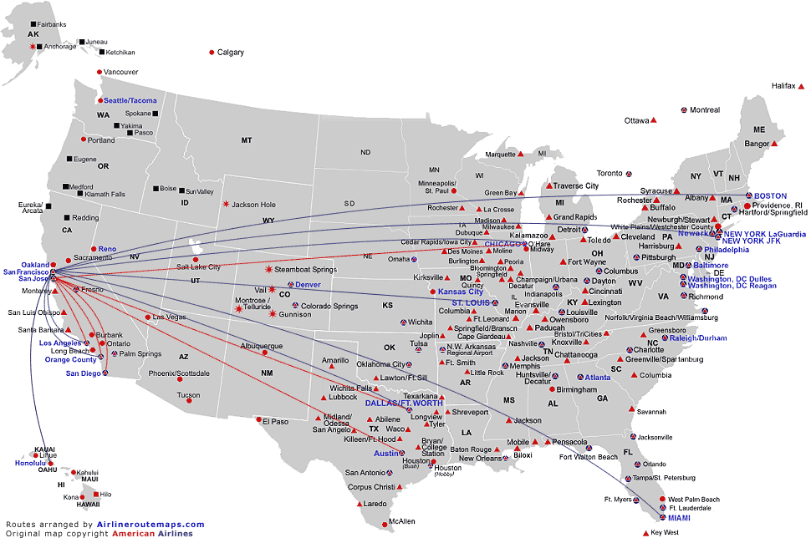
Approach: Hub Finding
Locate hubs in the network (or metric space) that are the most central.

Slide 17

Future Directions
Study geometric properties of networks, combining algorithmics, geography, and topology.

