Slide 1
Scalable Methods for the Analysis of Network-Based Data
MURI Project: University of California, Irvine
Project Meeting
August 25th 2009
Principal Investigator: Padhraic Smyth

Slide 2
Goals for Today’s Meeting
Introductions and brief review of our project
Technical presentations and discussion
  MURI-related research, different research groups
  Important to leave time for questions and discussion
    30 minute talks: finish in 25 mins
    15 minute talks: finish in 12 mins
  Goal is to spur discussion and interaction
End of day
  Open discussion: research, collaboration
  Organizational items: date of November meeting
  Wrap–up and action items
Butts

Slide 3







MURI Investigators
Padhraic Smyth UCI
David Eppstein UCI
Carter Butts UCI
Michael Goodrich UCI
Mark Handcock
U Washington
Dave Mount
U Maryland
Dave Hunter
Penn State

Slide 4
Collaboration Network
Mike
Goodrich
David
Eppstein
Dave
Hunter
Carter
Butts
Dave
Mount
Padhraic
Smyth
Mark
Handcock

Slide 5
Collaboration Network
Chris
Marcum
Zack
Almquist
Lowell
Trott
Darren
Strash
Ryan
Acton
Emma
Spiro
Lorien
Jasny
Sean
Fitzhugh
Mike
Goodrich
David
Eppstein
Duy Vu
Dave
Hunter
Carter
Butts
Ruth
Hummel
Dave
Mount
Padhraic
Smyth
Mark
Handcock
Eunhui
Park
Minkyoung
Cho
Arthur
Asuncion
Chris
DuBois
Miruna
Petrescu-Prahova
Qiang
Liu
Drew
Frank
Romain
Thibaux

Slide 6
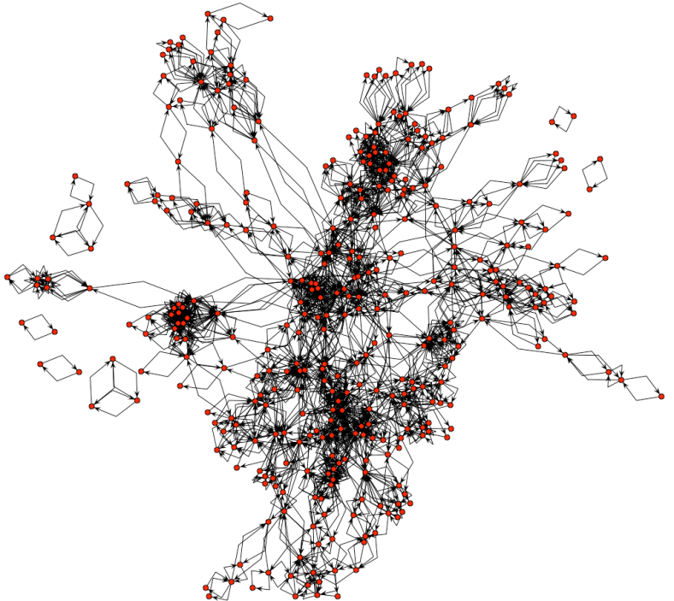
Data
Models
Predictions

Slide 7
Statistical Modeling of Network Data
  Statistics = principled approach for inference from noisy data
  Basis for optimal prediction
    computation of conditional probabilities/expectation
  Principles for handling noisy measurements
    e.g., noisy and missing edges
  Integration of different sources of information
    e.g., combining edge information with node covariates
  Quantification of uncertainty
    e.g., how likely is it that network behavior has changed?

Slide 8
Limitations of Existing Methods
Network data over time
  Relatively little work on dynamic network data
Heterogeneous data
  e.g., few techniques for incorporating text, spatial information, etc, into network models
Computational tractability
  Many network modeling algorithms scale exponentially in the number of nodes N

Slide 9
Example
G = {V, E}
  V = set of N nodes
  E = set of directed binary edges
Exponential random graph (ERG) model
  P(G | θ) = f( G ; θ ) / normalization constant
  The normalization constant = sum over all possible graphs
  How many graphs? 2 ^{N(N-1)}
  e.g., N = 20, we have 2³⁸⁰ ~ 10³⁸ graphs to sum over

Slide 10
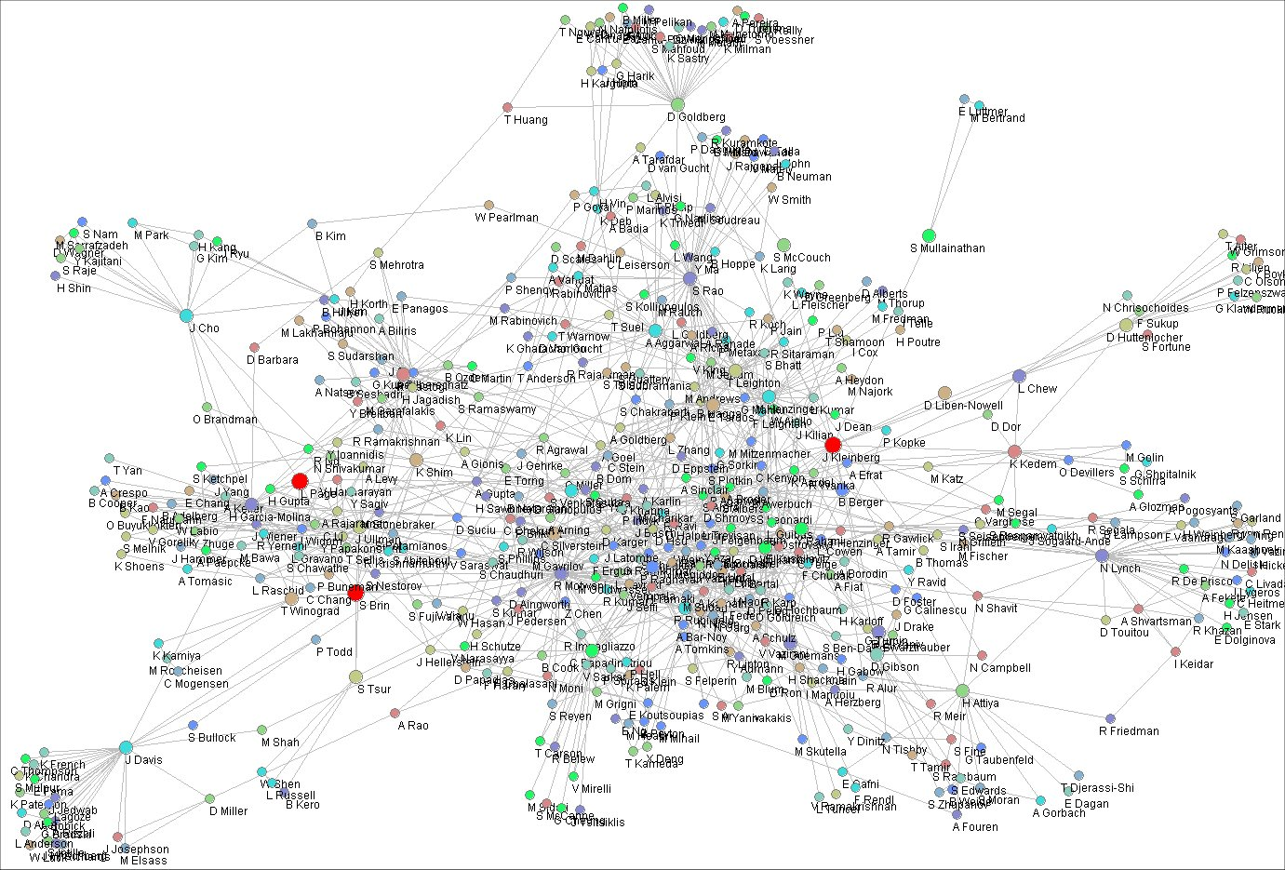

Slide 11
Key Themes of our MURI Project
Foundational research on new statistical estimation techniques for network data
  e.g., principles of modeling with missing data
Faster algorithms
  E.g., efficient data structures for very large data sets
New algorithms for heterogeneous network data
  Incorporating time, space, text, other covariates
Software
  Make network inference software publicly-available (in R)

Slide 12
Key Themes of our MURI Project
Efficient
Algorithms
New Statistical Methods
Richer models
Large
Heterogeneous
Data Sets
New
Applications
Software

Slide 13
Tasks
A: Fast network estimation algorithms
  Eppstein, Butts
B: Spatial representations and network data
  Goodrich, Eppstein, Mount
C: Advanced network estimation techniques
  Handcock, Hunter
D: Scalable methods for relational events
  Butts
E: Network models with text data
  Smyth
F: Software for network inference and prediction
  Hunter

Slide 14
Task A: Fast Network Estimation Algorithms
Investigators: Eppstein, Butts
Problem:
  Statistical inference algorithms can be slow because of repeated computation of various statistics on graphs
Goal
  Leverage ideas from computational graph algorithms to enable much faster computation – also enabling computation of more complex and realistic statistics
Projects
  Dynamic graph methods for change-score computation
  Rapid subgraph automorphism detection for feature counting
  Dynamic connectivity

Slide 15
Task B: Spatial Representations and Network Data
Investigators: Goodrich, Eppstein, Mount
Problem:
  Spatial representations of network data can be quite useful (both latent embeddings and actual spatial information) but current statistical modeling algorithms scale poorly
Goal
  Build on recent efficient geometric data indexing techniques in computer science to develop much faster and efficient algorithms
Projects
  Improved algorithms for latent-space embeddings
  Fast implementations for high-dimensional latent space models
  Techniques for integrating actual and latent space geometry

Slide 16
Task C: Advanced Estimation Techniques
Investigators: Handcock, Hunter
Problem:
  Current statistical network inference models often make unrealistic assumptions, e.g.,
    Assume complete (non-missing) data
    Assume that exact computation is possible
Goal
  Develop new theories and techniques that relax these assumptions, i.e., methods for handing missing data and techniques for approximate inference
Projects
  Inference with partially observed network data
  Approximation methods
    Approximate likelihood techniques
    Approximate MCMC algorithms
  Will leverage new techniques developed in Tasks A and B

Slide 17
Task D: Scalable Temporal Models
Investigator: Butts
Problem:
  Few statistical methods for modeling temporal sequences of events among a network of actors
Goal
  Develop new statistical relational event models to handle an evolving set of events over time in a network context
Projects
  Specification of relational event statistics
  Rapid likelihood computation for relational event models
  Predictive event system queries
  Interventions, forecasting, and “network steering”
  Can build on ideas from Tasks A, B, C

Slide 18
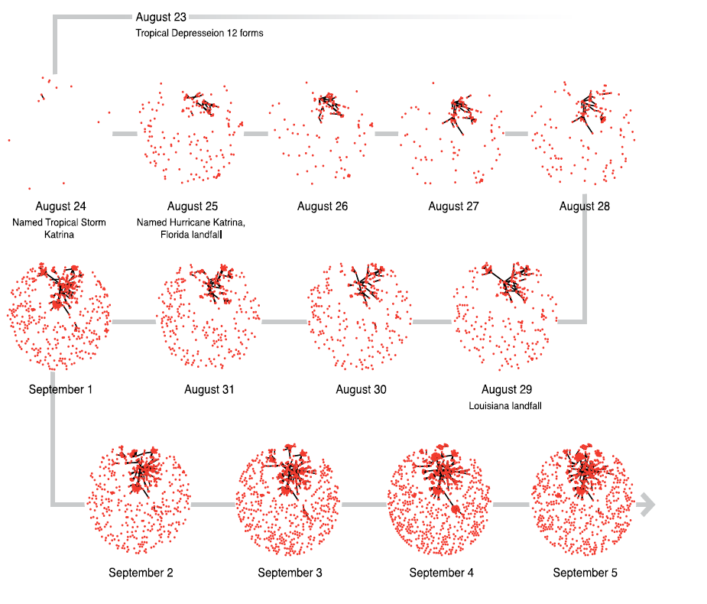

Slide 19
Task E: Network Models and Text Data
Investigator: Smyth
Problem:
  Lack of statistical techniques that can combine network and text data within a single framework (e.g., email communication)
Goal
  Leverage recent advances in both statistical text mining and statistical network modeling to create new combined models
Projects
  Latent variable models for text and network data
  Text as exogenous data for statistical network models
  Modeling of text and network data over time
  Fast algorithms for statistical modeling of text/networks
  Can build on ideas from Tasks A, B, C and D

Slide 20
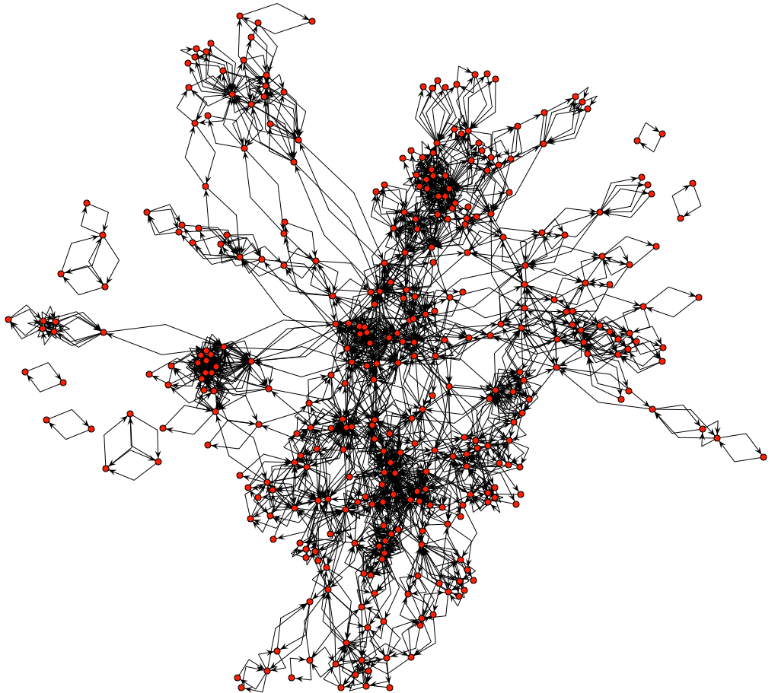
Network of email communication
patterns in HP Research Labs
over 6 month time-frame

Slide 21
Task F: Software for Network Inference and Prediction
Investigator: Hunter
Goal
  Disseminate algorithms and software to research and practitioner communities
How?
  By incorporating our new algorithms into the R statistical package
  R = open source language for stat computing/graphics
  MURI team has significant prior experience with developing statistical network modeling packages in R
    network (Butts et al, 2007)
    latentnet (Handcock et al, 2004)
    ergm (Handcock et al, 2003)
    sna (Butts, 2000)
Will integrate algorithms and techniques from other tasks

Slide 22
ONR Interests
(adapted from presentation/discussion by Martin Kruger, ONR)
How does one select the features in an ERG model?
How can one uniquely characterize a person or a network?
Can a statistical model (e.g., a relational event model) be used to characterize the trajectory of an individual or a network over time?
Can one do “activity recognition” in a network?
Can one model the effect of exogenous changes (e.g., “shocks”) to a network over time?
Importance of understanding social science aspect of network modeling: what are human motivations and goals driving network behavior?

Slide 23
Timelines and Funding
3-year project, possible extension to 5 years
  Start date: May 1 2008
  End date: April 30 2011/2013
Funding installment 1:
  First 5 months of funding, intended for May-Sept 2008
  Arrived at UCI in Sept 2008
  Largely spent by March 2008
Funding installment 2:
  12 months of funding, intended for Oct 1 08 to Sep 30 09
  Arrived at UCI mid-march 2009
  Plan to spend current funding by March 2010
Anticipate next installment will arrive in early 2010

Slide 24
Project Meetings
All-Hands Meeting, November 2008
  Researchers + ONR program manager (Martin Kruger) + other DoD folks
Working Meeting, April 2009
  Researchers
Working Meeting, August 2009
  Researchers + Julie Howell and Joan Kaina (Navy, San Diego)
All-Hands Meeting, November 2009
  Researchers + program manager + other DoD folks
  Exact date TBD

Slide 25
Research Examples
Statistical modeling of network data with missing observations
  Mark Handcock and Krista Gile
  Systematic statistical methodologies for handling missing edge information in observed network data
Decision-theoretic foundations for network modeling
  Carter Butts
  Network formation via stochastic choice processes and links to exponential random graph (ERG) models
Fast computation of graph change scores in large networks
  David Eppstein and Emma Spiro
  New data structure that significantly speeds up the evaluation of change-score statistics in ERG estimation

Slide 26
Sample Publications
C. T. Butts, Revisiting the foundations of network analysis, Science, 325, 414-416, 2009
R. Hummel, M. Handcock, D. Hunter, A steplength algorithm for fitting ERGMS, winner of the American Statistical Association (Statistical Computing and Statistical Graphics Section) student paper award, presented at the ASA Joint Statistical Meeting, 2009.
D. Eppstein and E. S. Spiro, The h-index of a graph and its application to dynamic subgraph statistics, Algorithms and Data Structures Symposium, Banff, Canada, August 2009
D. Newman, A. Asuncion, P. Smyth, M. Welling, Distributed algorithms for topic models, Journal of Machine Learning Research, in press, 2009

Slide 27
Sample Publications (ctd.)
M. Gjoka, M. Kurant, C. T. Butts, A. Markopoulou, A walk in Facebook: uniform sampling of users in online social networks, electronic preprint, arXiv:0906.0060, 2009
M. Cho, D. M. Mount, and E. Park, Maintaining nets and net trees under incremental motion, submitted, 2009
R.M. Hummel, M.S. Handcock, D.R. Hunter, A steplength algorithm for fitting ERGMs, submitted, 2009
C. T. Butts, A behavioral micro-foundation for cross-sectional network models, preprint, 2009

Slide 28
Morning Session I
9:30 Foundational aspects of network analysis
Carter Butts (UCI)
9:45 Comparison of estimation methods for exponential random graph models
Mark Handcock (UW)
10:15 Sampling algorithms for data collection in online networks
Carter Butts (UCI)
10:30 Break

Slide 29
Morning Session II
10:45 Egocentric network models for event data over time
Chris Marcum, Lorien Jasny, Carter Butts (UCI)
11:15 Dynamic extensions of network brokerage models
Ryan Acton, Emma Spiro, Carter Butts (UCI)
11:30 Statistical approaches to joint modeling of text and network data
Arthur Asuncion, Qiang Liu, Padhraic Smyth (UCI)
12:00 Lunch for all at University Club

Slide 30
Afternoon Session I
1:30 The crossroads of geography and networks
Michael Goodrich (UCI)
2:00 Maintaining nets and net trees under incremental motion
Minkyoung Cho, Eunhui Park, Dave Mount (U Maryland)
2:30 Simulation of spatially-embedded network data
Carter Butts (UCI)
3:00 A proposal for the analysis of disaster-related network data, Miruna Petrescu-Prahova (UW)
3:30 Break

Slide 31
Afternoon Session II
3:45 Approximate inference techniques with applications to spatial network models
Drew Frank, Alex Ihler, Padhraic Smyth (UCI)
4:15 Update on project data organization, assembly, and collection
Emma Spiro (UCI)
4:30 Discussion and Wrap-up
- date of AHM meeting in November
- collaborative activities
- action items
5:00 Adjourn

Slide 32
Logistics
Meals
  Lunch at University Club - for everyone
  Refreshment breaks at 10:30 and 3:30
Wireless
  Should be able to get 24-hour guest access from UCI network
Online Slides and Schedule
www.datalabl.uci.edu/TBD
Reminder to speakers: leave time for questions and discussion!

