Slide 1
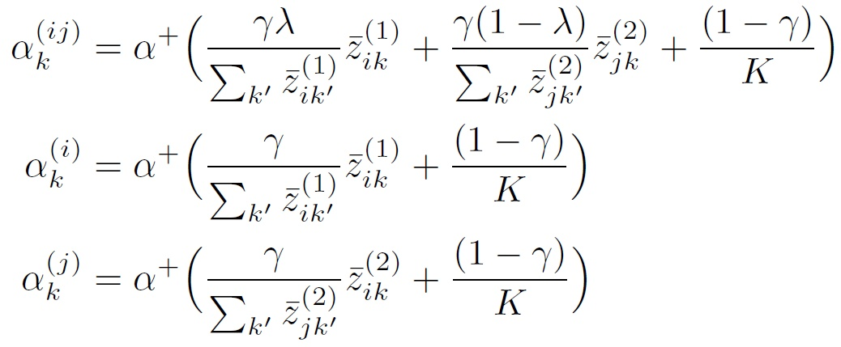
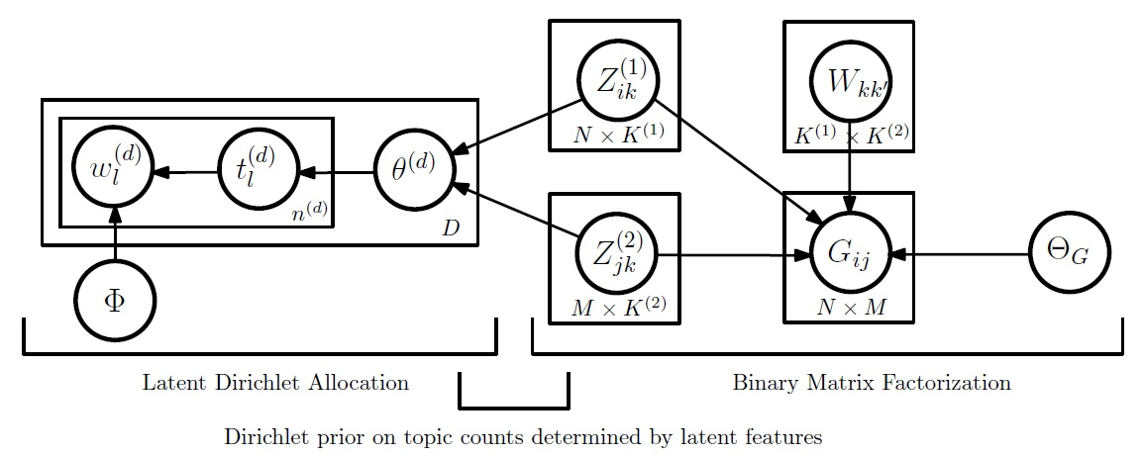
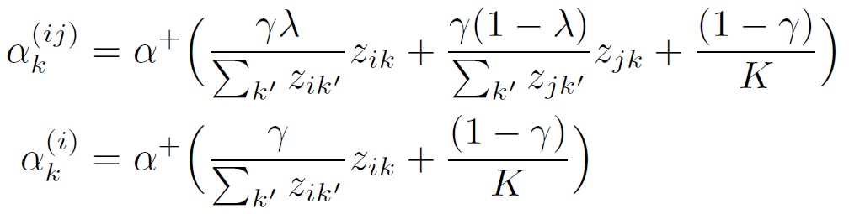
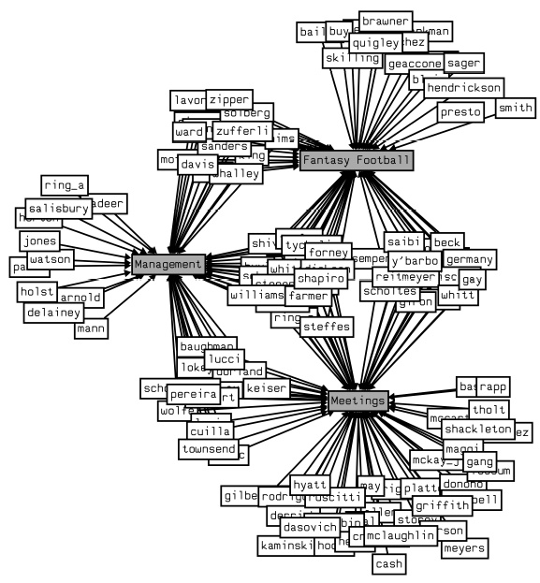
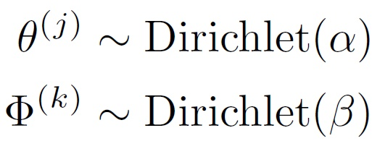
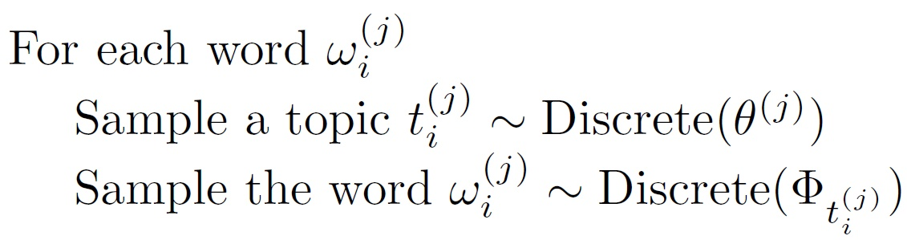
Interpretable Latent Feature Models
For Text-Augmented Social Networks
James R. Foulds, Padhraic Smyth
University of California, Irvine
Summary
We propose a framework for jointly modeling networks and text associated with them, such as email networks or user review websites. The proposed class of models can be used to recover human-interpretable latent feature representations of the entities in a network.
We demonstrate the model on the Enron email corpus.
The Nonparametric Latent Feature Relational Model (Miller et al., 2009)
Actor i represented by a binary vector of features Z_{i}
Number of features K learned automatically due to the non-parametric Indian Buffet Process prior on Z
Probability of edge between actor i and actor j is
Binary matrix factorization (BMF) , due to Meeds et al. (2007), is the rectangular matrix version of this model.
BMF_LDA: A Joint Model for Networks and Text
The generative process is assumed to be as follows:
Generate network via BMF (or LFRM)
Associate a topic with each latent feature
Generate documents via LDA, where the prior for each document’s topics depends on the latent features from BMF:
For rectangular networks, this is equivalent to:
Markov Chain Monte Carlo Inference
Gibbs updates on the latent features
  Metropolis-Hastings updates for Ws, using a Gaussian proposal
Collapsed Gibbs sampler for the topic assignments
Optimize the hyper-parameters
  Gradient ascent for λ, γ
  Iterative procedure for α⁺, due to Minka (2000).
Align the features and topics, maximizing the Polya log-likelihood via the Hungarian algorithm.
Latent Variable Network Models
Find low-dimensional representations of the actors
Conditional independence assumptions improve tractability
Unifying view: probabilistic matrix factorization
The NxN network Y is assumed to be generated via
E.g. MMSB (Airoldi et al. 2008),
LFRM (Miller et al. 2009), RTM (Chang and Blei 2009),
Latent Factor Model (Hoff et al. 2002),…
Two mode networks and other rectangular matrix data:
Logistic function (or other link function)
Feature interaction weights
Cycling
Fishing
Running
A
B
Tango
Salsa
C
Waltz
Running
Feature
Z =
 | Cycling | Fishing | Running | Tango | Salsa | Waltz
A
B
C
Actor
NxN
NxK
KxK
KxN
Y ∼ f(Λ),
Λ
=
Z
W
Z^{T}
Variable interaction terms (optional)
Latent Dirichlet Allocation (Blei, Ng & Jordan, 2003)
A probabilistic model for text corpora
Topics are discrete distributions over words
Each document has a distribution over topics
We can also view LDA as a factorization of the matrix of word probabilities for each document.
Future Work / Work in Progress
Evaluate the recovered features
Quantitative experiments
Results on the Yelp dataset
Latent variables
NxM
NxK⁽¹⁾
K⁽¹⁾xK⁽²⁾
K⁽²⁾xM
Λ
=
Z⁽¹⁾
W
Z^{(2)T}
References
D.M. Blei, A.Y. Ng, and M.I. Jordan. Latent Dirichlet allocation. The Journal of Machine Learning Research, 2003.
K.T. Miller, T.L. Griffiths, and M.I. Jordan. Nonparametric latent feature models for link prediction. NIPS, 2009.
E. Meeds, Z. Ghahramani, R. Neal, and S. Roweis. Modeling dyadic data with binary latent factors. In Advances in neural information processing systems, 2007.
Notes:
This poster template is from http://www.swarthmore.edu/NatSci/cpurrin1/posteradvice.htm. It is free, free, free for non-commercial use. If you really like it, I’m always thrilled to get postcards from wherever you happen to be presenting your poster. -- Colin Purrington, Department of Biology, Swarthmore College, Swarthmore, PA 19081, USA. cpurrin1@swarthmore.edu

