Slide 1
Algorithms and Data Structures for Fast Computations on Networks
Michael T. Goodrich
Dept. of Computer Science
University of California, Irvine

Slide 2
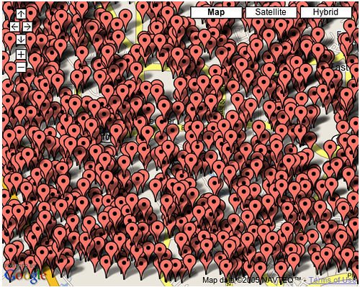
The Need for Good Algorithms
Data overload:
To facilitate improved network analysis, we need fast algorithms and efficient data structures.
  Large data sizes
  Sophisticated statistics
Image from http://cdn.venturebeat.com/wp-content/uploads/2009/03/28811286_e1671e30a9.jpg

Slide 3
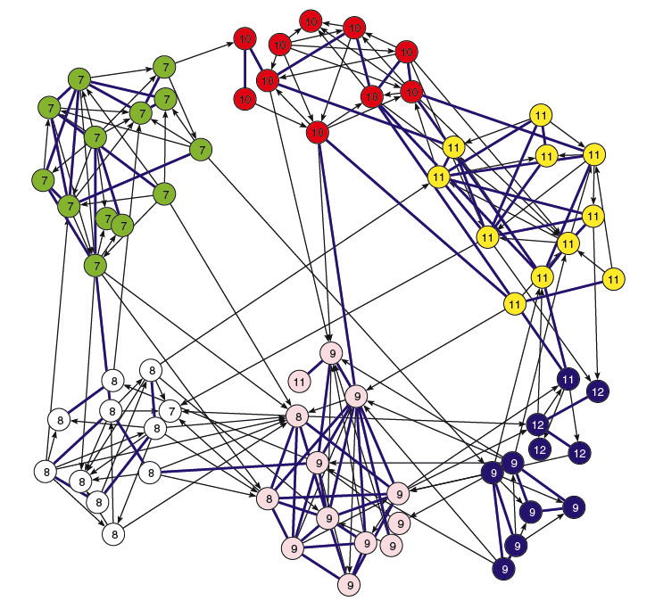
Latent Space Embeddings
View the vertices in a network as embedded in d-dimensional space.
Correlate geometric distance with natural clusters and other network information
Hoff, P., Raftery, A.E. and Handcock, M.S. (2002). Latent space approaches to social network analysis. Journal of the American Statistical Association, 97, 1090-1098.

Slide 4
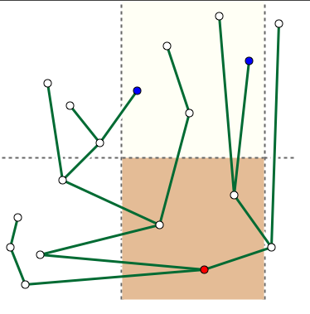
Data Structures for d-Dimensional Space
Updates:
  insert(p)
  remove(p)
  changePosition(p,q)
Queries:
  range(x₁,x₂,y₁,y₂)
  nearestNeighbor(p)
  …
More on this topic will be provided by Dave Mount.

Slide 5
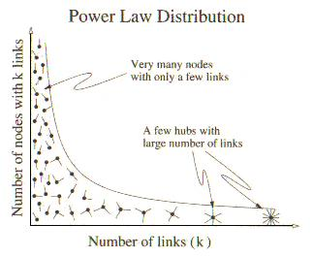
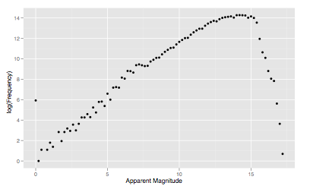
Priority Range Trees
Data structures that are more efficient for data exhibiting power-law distributions
Image from http://www.macs.hw.ac.uk/~pdw/topology/Pictures/S-power.jpg
M.T. Goodrich and D. Strash, “Priority Range Trees,”
21st Int. Symp. on Algorithms and Computation (ISAAC), 2010.

Slide 6
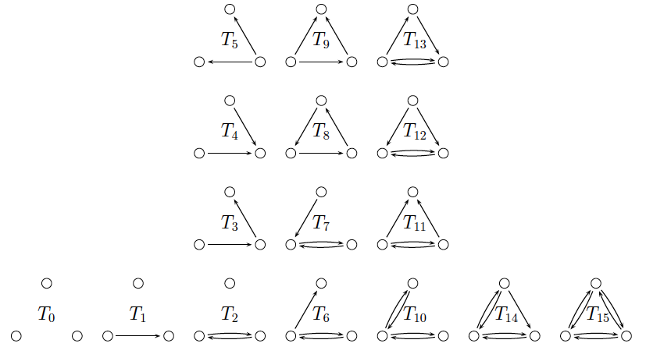
Subgraph Statistics
Maintaining subgraph statistics dynamically can speed up ERGM computations.
D. Eppstein, E. S. Spiro, “The h-Index of a Graph and its Application to Dynamic Subgraph Statistics,” Algorithms and Data Structures Symposium, Banff, Canada, 2009.
D. Eppstein, M.T. Goodrich, D. Strash, and L. Trott, ``Extended Dynamic Subgraph Statistics Using h-Index Parameterized Data Structures,’’ 4th Annual International Conference on Combinatorial Optimization and Applications (COCOA), 2010.

Slide 7
H-Index
We have designed several data structures based on the H-index.
H: maximum number such that there are at least H nodes with degree at least H.
More on this
topic will be
provided by
Lowell Trott
(poster).
Image from http://www.macs.hw.ac.uk/~pdw/topology/Pictures/S-power.jpg

Slide 8
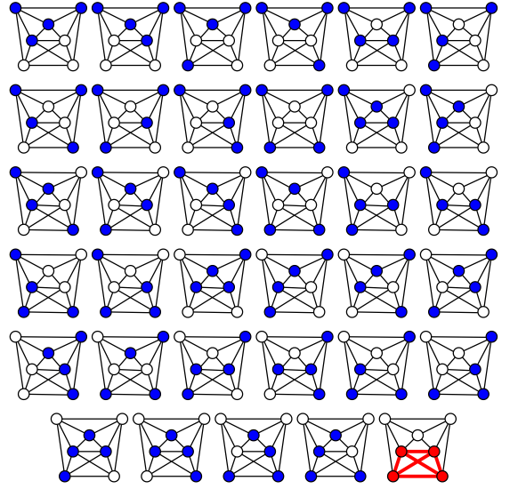
Clique Finding
In a social network, where vertices represent people and edges represent relationships, a largest subset of people who all know each other, defining mutual acquaintances, is a clique.
Finding all maximal cliques is useful.
Image from http://en.wikipedia.org/wiki/File:Brute_force_Clique_algorithm.svg

Slide 9
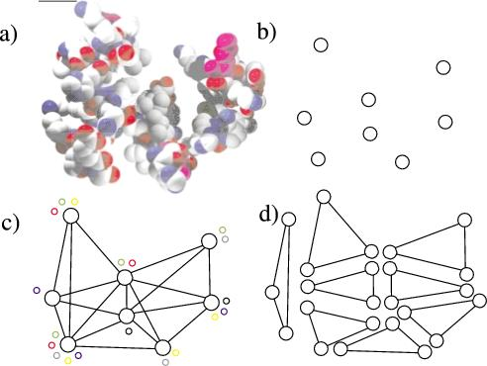
Fast Clique Finding
The Bron–Kerbosch algorithm is an algorithm for finding maximal cliques in an undirected graph.
We have designed a major improvement to the Bron-Kerbosch algorithm.
This improvement is implemented and interfaced with the R system.
  paper yet to appear.
More on this topic will be provided by Darren Strash.
Image from http://cnx.org/content/m11538/latest/

Slide 10
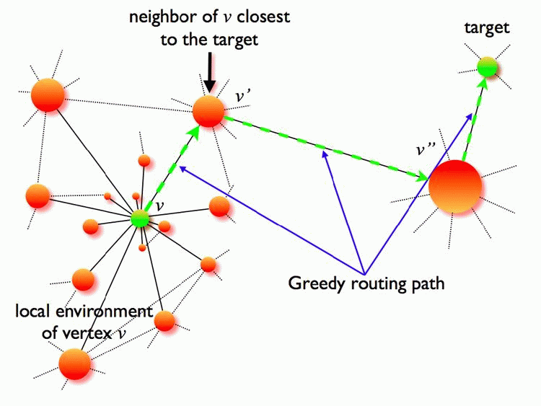
Routing in Social Networks
Greedy routing is an approach that has been used since the earliest days of network analysis.
We are interested in when, where, and how it works.
Image from http://cdn.physorg.com/newman/gfx/news/hires/2009/Greedyrouting.gif

Slide 11
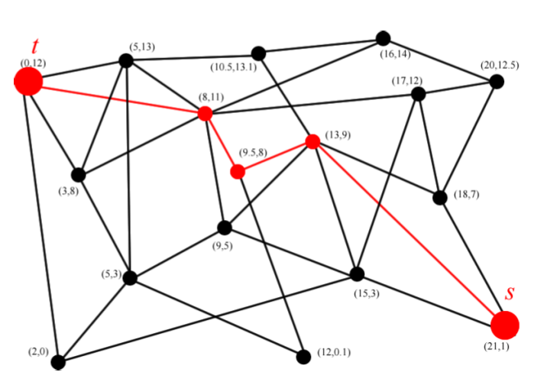
How Greedy Routing Works
A form of “geographic” routing
Hyperbolic space
Euclidean space
D. Eppstein and M.T. Goodrich,``Succinct Greedy Geometric Routing Using Hyperbolic Geometry,’’ IEEE Transactions on Computers, to appear.
M.T. Goodrich and Darren Strash, ``Succinct Greedy Geometric Routing in the Euclidean Plane,’’ 20th Int. Symp. on Algorithms and Computation (ISAAC), 2009, 781-791.

Slide 12

Breakthrough Ideas (so far)
Viewing networks as d-dimensional point sets and then providing good data structures.
Deriving efficiency from data distributions.
Add fast clique finding as a tool for network analysis.
Studying relationships between connectivity and geography.
The Geography Lesson (Portrait of Monsieur Gaudry and His Daughter),
oil on canvas painting by Louis-Léopold Boilly, 1812, Kimbell Art Museum

Slide 13
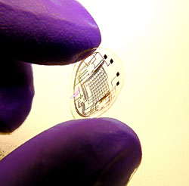
Future Work
Understanding and exploiting the special properties of temporal data.
A richer set of effective tools for network analysis.
Studying network phenomena, such as connectivity, communication, and influence through an algorithmic lens.
Image from http://www.guardian.co.uk/technology/blog/2008/feb/24/heresachipinyoureye

Slide 14

Retroactive Data Structures
Operations have a time parameter:
  insert(t,x), delete(t,x), query(t,x)
  Insertions and deletions can happen in the “past” so long as they are consistent with the time line
  Updates in the past propagate effects forward
  Queries can be done in the present (partially retroactive) or in the past (fully retroactive)
“Back to the Future” is owned by Universal Pictures

Slide 15
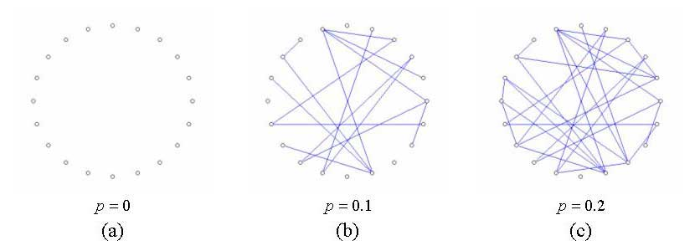
Usefulness of Retroactivity
Developing an algorithmic “language” with which to reason about time.
Designing structures to manage temporal data
  paper yet to appear.
More on this topic will be provided by Joe Simons (poster).
Image from http://chemoton.files.wordpress.com/2010/04/erdos-renyi-random-graph-evolution1.jpg

Slide 16
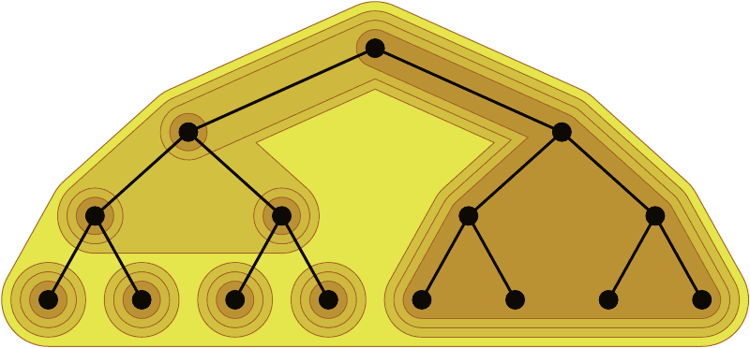
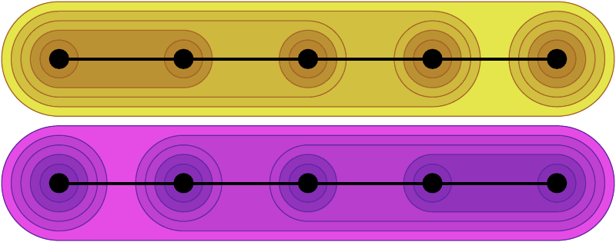
Category-based Routing
People often see the world in terms of clusters and categories.
Is it possible for information routing to use category counting as a notion of distance?
  Yes, with a polylogarithmic number of categories
  More work is needed on real-world categories.
  ongoing work…

Slide 17
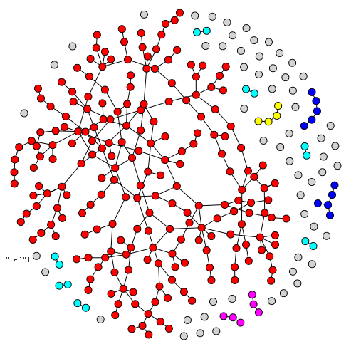
Network Analysis Through the Algorithmic Lens
Can a sparse random network quickly sort just by doing neighboring compare-exchanges?
Yes, if there are a lot more nearby connections than distant ones.
  There is a family of random networks of O(n log n) edges, each of which sorts its elements in time O(n log n) with high probability.
  paper is yet to appear.
Image from http://webscripts.softpedia.com/screenshots/The-IGraph-Library_4.png

